Slide 1
Temple Broadband Expansion Initiative
Prepared for the residents of Temple
By the Temple CAC Broadband Committee
April 22, 2021
Jessica Hipp
Christine Robidoux
Keith Charlton
Dana Nowell
Mike Flynn

Slide 2
Town of Temple Master Plan
Vision Statement
Home businesses should be allowed and encouraged.
Temple should coordinate with electrical and communications utilities to facilitate meeting the needs of its residents and businesses.
Economic Development
The business landscape is changing...as computer technology and service availability has enabled some residents to telecommute and has provided opportunities for others to create their own home-based businesses.

Slide 3
Primary Goals
Provide access to broadband internet to 100% of Temple residents
Minimize impact on taxpayers
Secondary Considerations
Provide service that will meet future needs…>25/3
How to control costs to individual subscribers
Many residents have long driveways and have received high quotes to run line from the street to their house

Slide 4
Why are we looking at this?
Discontent with internet reliability and service expressed extensively on Facebook and a survey conducted in spring 2020.
Anecdotal evidence of internet problems through public discourse
COVID-19 Pandemic highlighting inequitable internet access for students and “work from home” families/individuals.
Increase or maintain property values
Enable expanded public participation in town forums, meetings and events
Promote economic development as highlighted in the Master Plan.

Slide 5
Public vs. Private Benefit Findings
By improving the speed, reliability, and cost over existing service, the following are areas where town residents and businesses benefit at no cost to taxpayers:
Economic Impact:
- Improves infrastructure for business development:
Supports small/home-based businesses
Improves ability of residents to telecommute
Improves access to employment opportunities
- Improves desirability for home buyers to purchase in Temple
- Increases the value of your home

Slide 6
Public vs. Private Benefit Findings (cont.)
Educational
Improved Internet access for students
Improved access to higher education for adult learners
Public Access
Enable residents to fully participate virtually on town committees, forums, and hearings during health emergencies like COVID-19
Safety
Fire Dept and Highway Dept communications enhanced
Enhanced quality of living
Every home has access to online services: i.e. streaming movies, CCiTV, telemedicine, shopping, etc

Slide 7
Current Providers
Town residents and businesses are served by:
DSL provider Consolidated Communications
Cable TV provider Comcast
Others utilize TDS, satellite internet or various 4G cellular providers.
DSL service over copper phone lines is limited by distance from a “central office” switch box, which are distributed throughout town.
Cable internet connections are copper coaxial cable with shared bandwidth, resulting in decreased speed with more data consumption within a neighborhood.

Slide 8
FCC defines broadband as...
25 Megabits per second (Mbps) download speed or greater
3 Mbps upload or greater
Netflix recommends a 25 Mbps speed for streaming its top quality video, while Amazon says you’ll need at least 15 Mbps. (Consumer Reports, 2019)
Notes:
https://www.consumerreports.org/broadband/internet-fast-enough-for-streaming-broadband-speed/

Slide 9
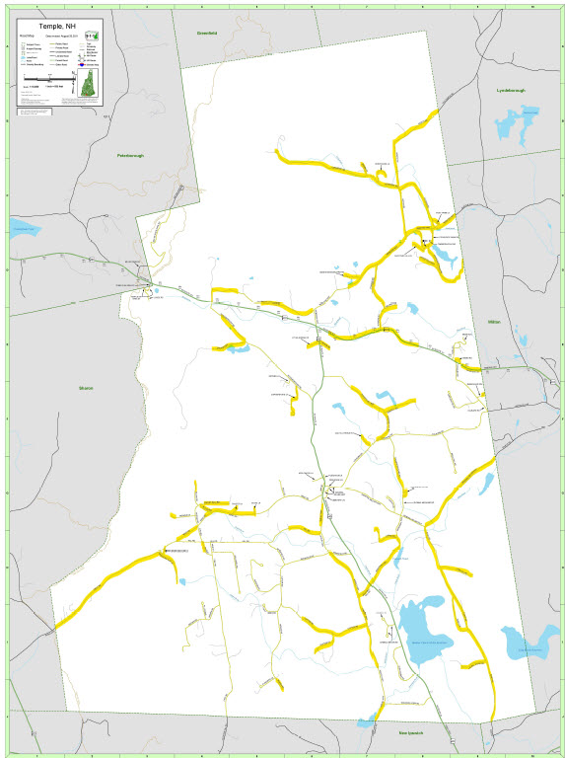
55.4% Unserved
% of Temple that does not meet the FCC-designated speeds to be considered broadband, based on road mileage.
Highlighted roads in yellow are underserved or unserved.

Slide 10
Request for Proposal (RFP)
Initial RFP sent Sept. 20, 2020. Revised RFP sent Jan. 27, 2021
Town received proposals from:
Comcast
Consolidated Communications (CCI)
Upon receiving and reviewing proposals, the committee ranked the responses and recommended the Select Board accept the proposal from Consolidated Communications (CCI).

Slide 11
Highlights of CCI Proposal
All residents in town will be eligible for Broadband Internet with speeds up to 1GB/Second.
As long as there is a communication path from the pole to the house (aerial or through conduit) there will be no charge for install.
Requires us to bond approx. $710,435 over 20 years for infrastructure (SB170), which CCI guarantees, resulting in ZERO COST TO THE TOWN.
CCI invests an additional $1.1M in the network.
CCI will charge an Infrastructure Fee to not to exceed $14/month to re-pay the bond. Residents of Temple only pay the fee IF they subscribe to the new service.

Slide 12
Funding through a Public/Private Partnership: NH Senate Bill 170
Allows municipalities to pay for “financing of improvements” to broadband infrastructure for locations unserved with a bond approved at town meeting.
Note: SB 170 does NOT require a fiber solution. It only requires a solution that provides = or > 25/3 service.
Send Requests for Information (RFI) from current internet providers - Sent 6/12/20
Receive information about current internet subscribers’ service - Received from CCI 6/25/20, Received from Comcast 8/3/20

Slide 13
NH Senate Bill 170
c. Send Requests for Proposals (RFP) allowing providers to craft and pitch a solution to provide service
d. “A municipality may select a proposal ... which meets or exceeds the anticipated needs of the community.” – Select Board accepted proposal from CCI on 2/5/21
e. Bonds must be passed at an annual or special town meeting with 2/3 approval of the voters. (RSA 33:8-a) - Town Meeting is scheduled 6/12/21
Notes:
RFP sent to:
Matrix Design Group
TDS
Comcast
ValleyNet
Consolidated Communications (CCI)
WiValley

Slide 14
Bonding
The CCI proposal requires a Municipal General Obligation Bond of $710,435 from the NH Bond Bank or another local lender.
CCI pays Temple the bond payments and supplements their funds with a (not to exceed) $14/month Infrastructure Fee per subscriber
During the roll-out, while the subscriber base is insufficient to cover the bond cost, CCI will make up any difference.
Again, there will be NO TAX IMPACT ON THE TOWN and ONLY SUBSCRIBERS PAY THE INFRASTRUTURE FEE.
Requires 4 public hearings and a ⅔ vote in favor at June 12 Town Meeting.

Slide 15
Additional Info
Town will own the network for at least 20 years, depending upon bond type.
CCI will retain right of exclusive use to run and maintain the network.
Internet service will be significantly faster and more reliable than existing DSL network.
Temple Select Board and CAC Broadband Committee are currently negotiating the contract with CCI.
Subscribe to e-Alerts News & Announcements on the Temple Website TempleNH.org for information about upcoming Broadband forums/hearings.

Slide 16
If you have questions
Email:
TempleBroadband@TempleNH.org
Or Call:
Select Board Assistant at (603) 878-2536

